Slide 1



Can you predict the future? Introduction to the NEON Forecasting Challenge
Workshop lead: Contact:
Notes:
Text highlighted in pink should be modified where appropriate.
Slides relating specifically to the terrestrial theme are hidden but can be used in place of those about the aquatics theme.

Slide 2
Workshop overview
Objectives:
Highlight some key concepts of ecological forecasting
Introduce NEON and the Forecasting Challenge
Walk through a simple forecast workflow
Point to resources to get involved and find more information
Notes:
List your primary objective for the workshop. This might be introducing forecasting as a concept, developing forecast workflows, using forecast models, and/or automating forecasts

Slide 3
Workshop Overview
11:30-11.55 Introductory presentation
11.55-12.10 Break and R set-up
12:10-13:00 Hands-on coding/follow- along
Notes:
A rough schedule for the workshop. The Submit_forecast tutorial are designed to be completed in a 90-minute workshop

Slide 4
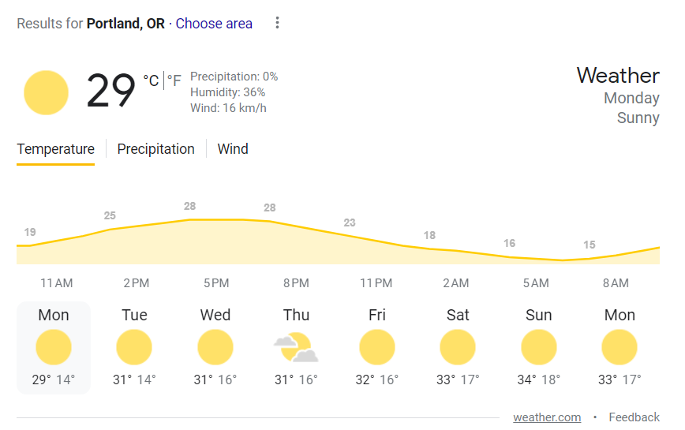
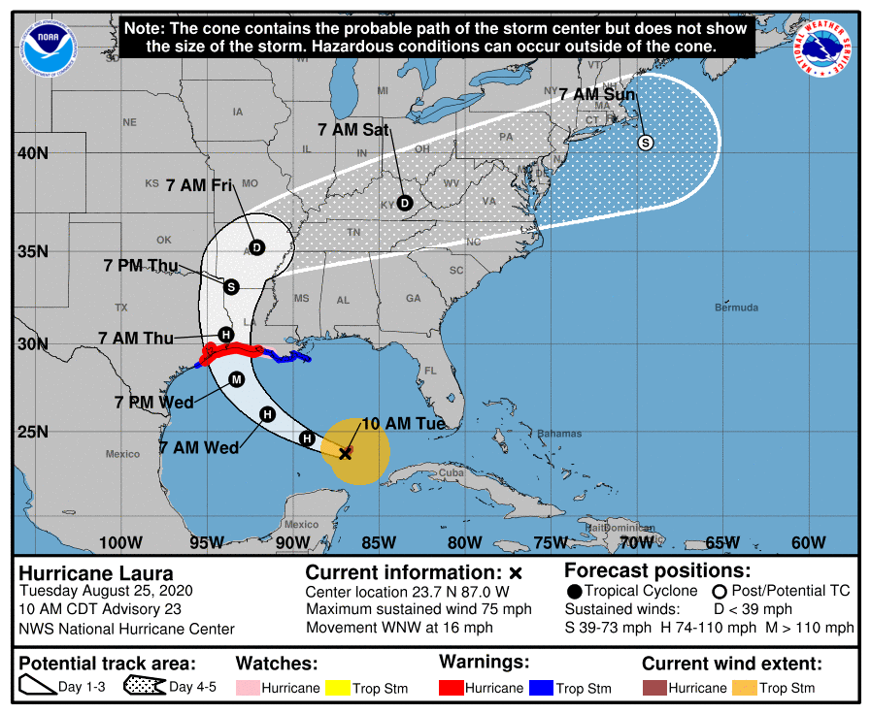
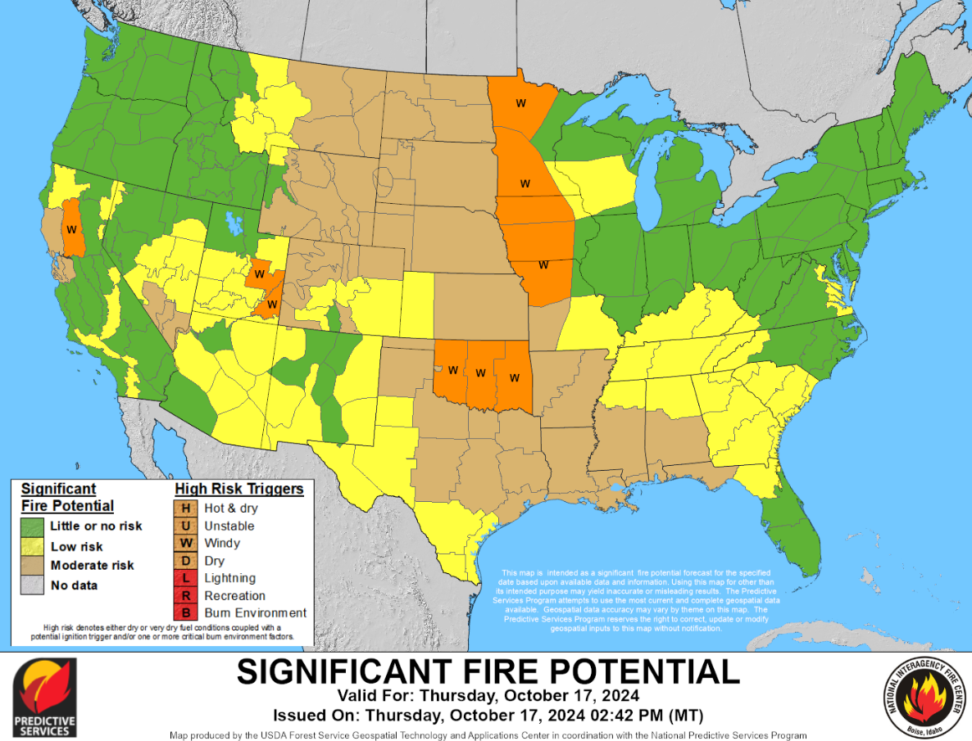
Why forecast?
Notes:
How many people looked at the weather this morning? Or last weekend when you were packing for a weekend trip? Weather forecasts are also crucial for emergency planning with natural disasters such as hurricanes, forecasts for the wildfires and associated air quality.
Similarly in ecology, these near term forecasts may prove to be equally valuable for managing ecosystems and informing public.
Figures show a Google 7 day weather forecast; a NOAA hurricane forecast for Hurricane Laura 2020; NICC 7-day fire potential outlook

Slide 5
Near-term, iterative, ecological forecasts
Near-term = sub-daily to decadal timescales
Iterative = process of repeatedly validating forecasts, updating model initial conditions and parameters, and issuing new forecasts as new data become available
Ecological forecast = future predictions of physical, chemical, or biological variables with quantified uncertainty
Notes:
What is meant by a near-term, iterative, ecological forecast? It is useful to define what is and isn’t meant when we use these terms (at least for these materials specifically.
Near-term – we are focusing on predictions occurring on a sub-daily to decadal time scale. These are not climate projections.
Iterative – the act of continually updating and rerunning a forecast workflow. We don’t just make a single one-off forecast but are constantly evaluating, updating and generating new forecasts as more data are collected.
Ecological forecast – in this scenario we are making real future predictions of the environment. Importantly the forecast needs to include estimates of uncertainty. Because they are real-time forecasts they inherently have uncertainty that should be quantified and communicated as part of the prediction.

Slide 6

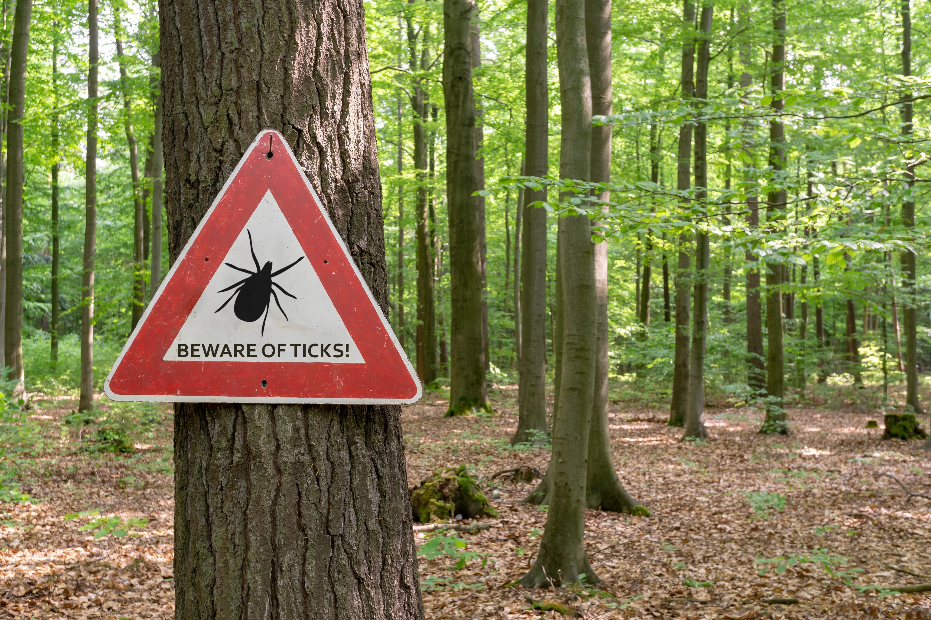
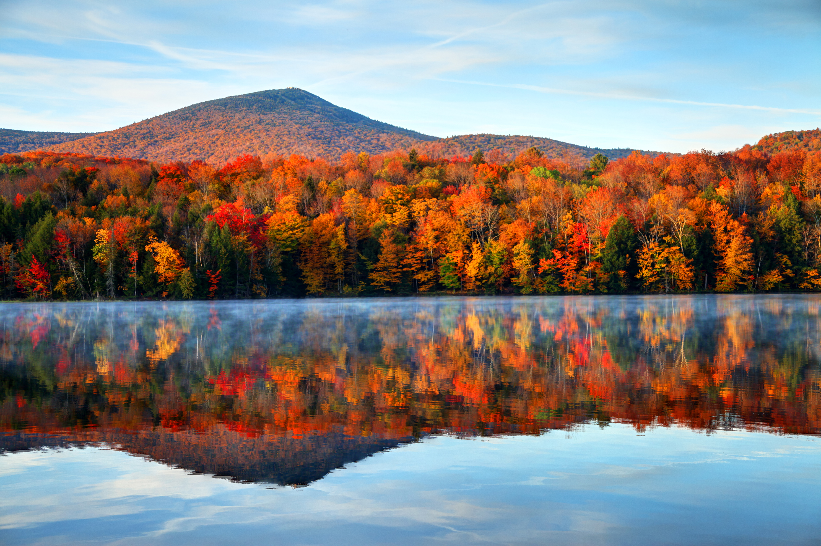
Examples:
Getty Images/iStockphoto
Getty Images/iStockphoto
Forecast of river dissolved oxygen concentration for the next 1-48 hours for fish stocking
1-3 month ahead predictions of the % chance of leaf fall to estimate peak leaf-peeping
Forecasts of tick abundance for the next 1-30 days in a popular hiking area
Getty Images/iStockphoto
Notes:
Some examples of some near term, iterative, ecological forecasts.
Note these relate to the NEON Forecasting Challenge themes (aquatics, ticks, phenology)

Slide 7
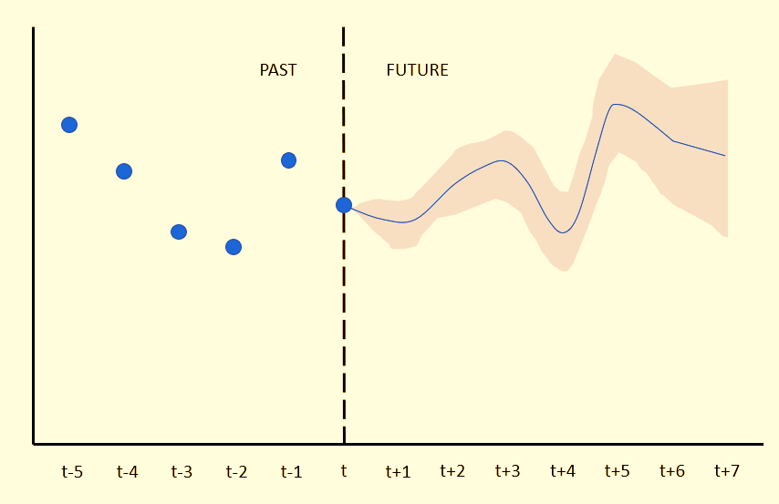
Ecological variable
Notes:
Example of what we mean by a forecast and how you could visualize it. Past observation as points, future prediction (generated at dotted line), with uncertainty

Slide 8
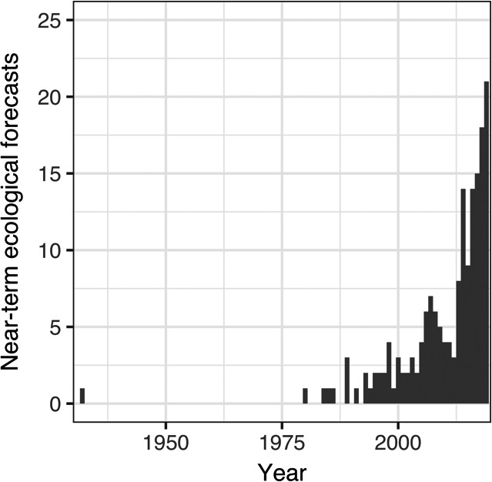
Ecological forecasting
An emerging and growing field
Lewis et al., 2021 (https://doi.org/10.1002/eap.2500)
Notes:
Ecological forecasting is a relatively new field but one that has the potential to have both applied and fundamental outcomes.
Lots to learn about predictability, best methods etc.

Slide 9
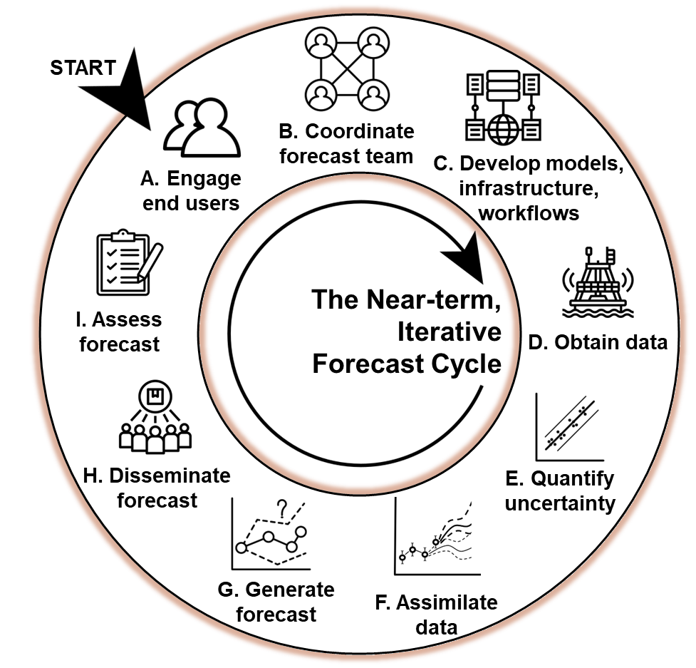
Forecasting Challenges
Forecasting is challenging!
Lofton, M. E et al. (2023) https://doi.org/10.1111/gcb.16590
A Challenge to catalyze progress
Notes:
The endeavour of producing a real-time forecast is not easy given the infrastructure needed to collect, disseminate data, develop and deploy models, evaluate and distribute forecasts to end-users. In addition the iterative nature of the forecast cycling requires these steps occur in a reproducible and repeatable way.
In other fields such as economics and computing competitions and challenge have been used as a way to forward the field and provide cohesion amongst researchers. An organising venture/enterprise for the community

Slide 10
Why a forecasting challenge? – the power of many forecasts!
A community of forecasting
Standards
Development of tools and infrastructure
A forecasting platform
2. Answer questions of predictability
Predictability
Variables
Models
Sites
Horizon, lead time
The EFI-NEON Forecasting Challenge was born (2021)!
Notes:
A Challenge has two potential values:
Generates a community of forecasters with common standards of production, submission, evaluation etc.
Start to answer questions of predictability across a range of scales (models, sites, variables). NEON data is perfect for this

Slide 11

Ecological Forecasting Initiative Research Co-ordination Network
EFI RCN Goals
lower barriers
community building
infrastructure
platform development
EFI RCN supported by NSF grant DEB-1926388
Notes:
Challenge coordinated by the Ecological Forecasting Initiative Research Coordination Network as a means to engage more people
Partnered with NEON for the Challenge

Slide 12
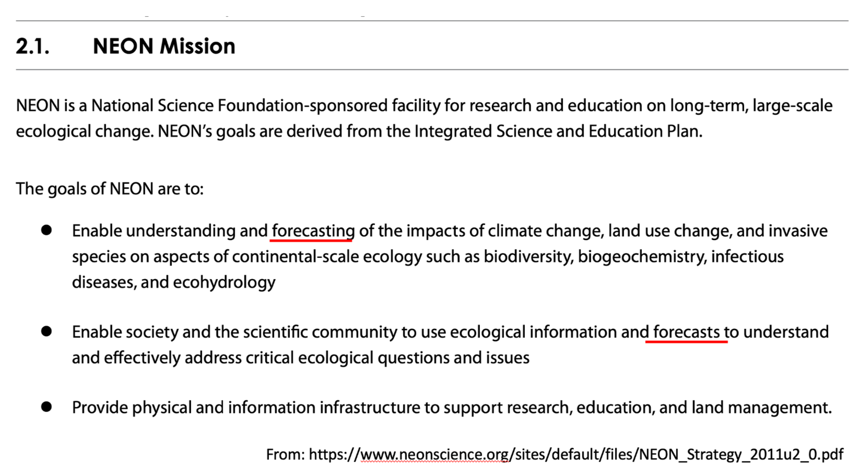
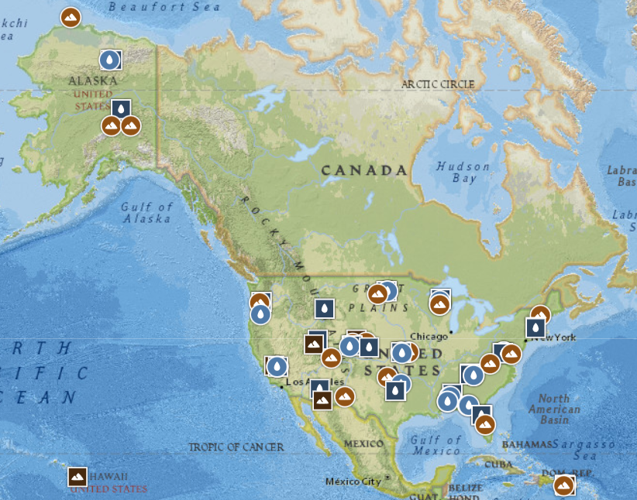


What is ?
The National Ecological Observatory Network (NEON) is a continental-scale observation facility
To collect long-term open access ecological data
47 terrestrial and 34 aquatic sites
NEON sites across the US
Notes:
The Challenge leverages the continental scale ecological observatory network (NEON) that collects data across the US from 81 different sites.
A screenshot from the NEON justification in early 2000s shows that “forecast ecosystems“ is key goal within the NEON mission.

Slide 13
What is the EFI-NEON Challenge?
ticks
beetles
phenology
terrestrial
aquatics
Forecasting Challenge Themes
“A platform for the community to make predictions of conditions at NEON sites before the data are collected”
All 81 sites
6 themes
Notes:
The Challenge covers 5 themes across ecology: Ticks, beetles, phenology, terrestrial daily, terrestrial subdaily, aquatics
Created a platform for the ecological forecasting community to make

Slide 14
What is the EFI-NEON Challenge?
“A platform for the community to make predictions of conditions at NEON sites before the data are collected”
All 81 sites
6 themes
> 15,000 forecast submitted!
Forecast = A prediction of future environmental conditions that includes quantified uncertainty
Thomas, et al. (2023). The NEON Ecological Forecasting Challenge. Frontiers in Ecology and the Environment, 21(3), 112–113. https://doi.org/10.1002/fee.2616
Notes:
The Challenge has created a platform for the ecological forecasting community to make forecasts and do synthesis
More information on the Challenge at Thomas et al 2023.
Updating the numbers can be found here: https://projects.ecoforecast.org/neon4cast-ci/ (look for Total forecasts submitted to the NEON Challenge at the bottom of the first page)

Slide 15
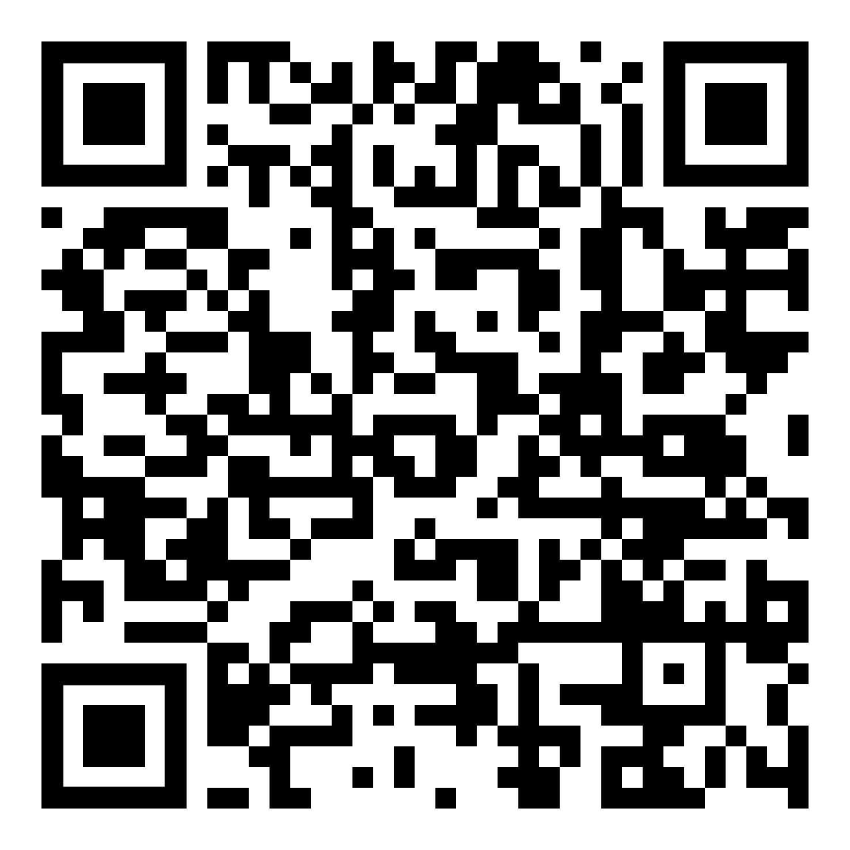
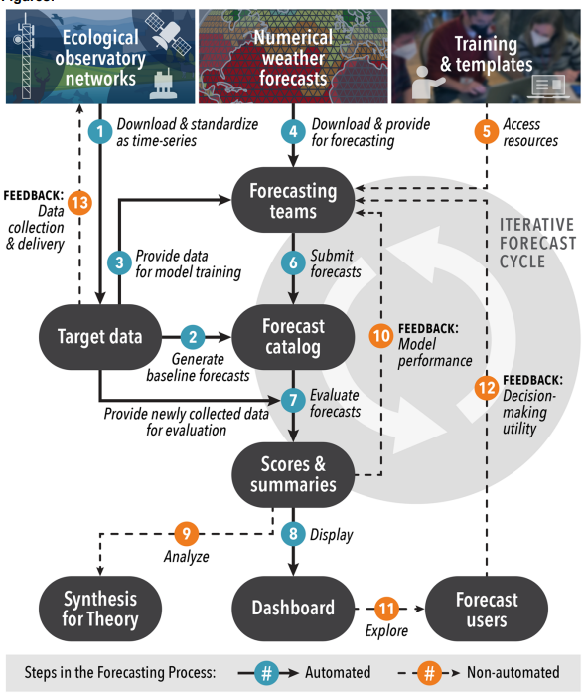
Challenge overview
Thomas, et al. (2023). The NEON Ecological Forecasting Challenge. Frontiers in Ecology and the Environment, 21(3), 112–113. https://doi.org/10.1002/fee.2616
Notes:
Use this slide to walk through the steps of the challenge. The materials here focus on Forecasting Teams submitting forecasts. The CI implemented by organisers has taken care of a lot of the rest of the workflow
Full paper at QR code – great for an overview (pre-reading etc.)!

Slide 16
Workshop overview
Objectives:
Highlight some key concepts of forecasting
Introduce NEON and the Forecasting Challenge
Walk through a simple forecast workflow
Point to resources to get involved and find more information
Notes:
Time for questions and discussion

Slide 17
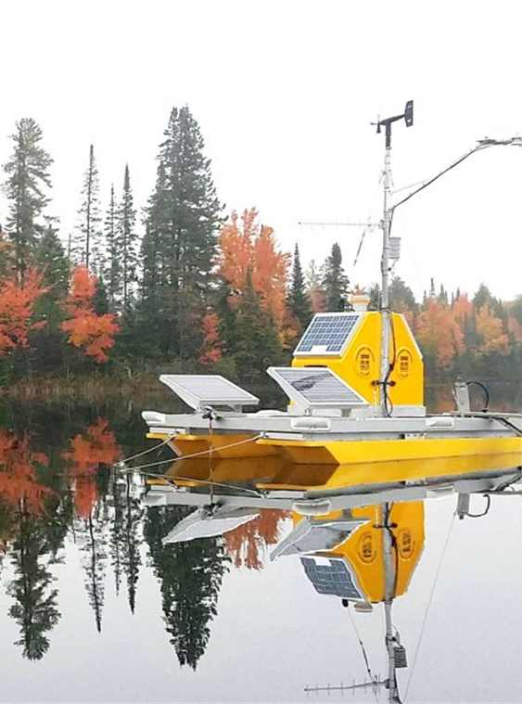
Hands-on workshop:
Water temperature = key variable in driving many biogeochemical cycles and habitat available for thermal-sensitive species
Aquatics theme – Can we predict how water temperature will change over the next month?
Water temperature in lakes
NEONs water temperature data product (DP1.20264.001)
30 day forecast horizon
Data latency of 2-3 days
Simple baseline model to build on
NEON Buoy at Crampton Lake (Land O’Lakes, WI)
Notes:
An overview of the data and questions we are working with in this tutorial.
Why water temperature?
We are using a simple model (not necessarily a good forecast) to demonstrate a full workflow (from data to models, uncertainty, and submission)

Slide 18
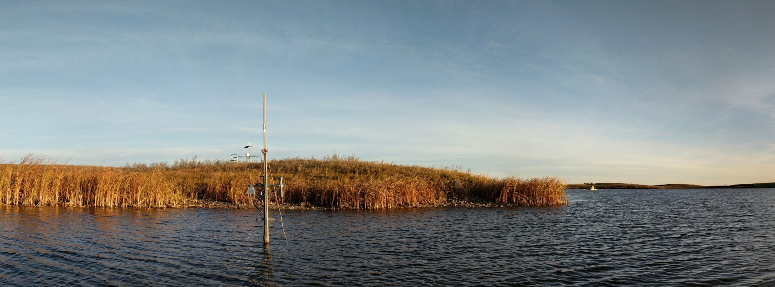
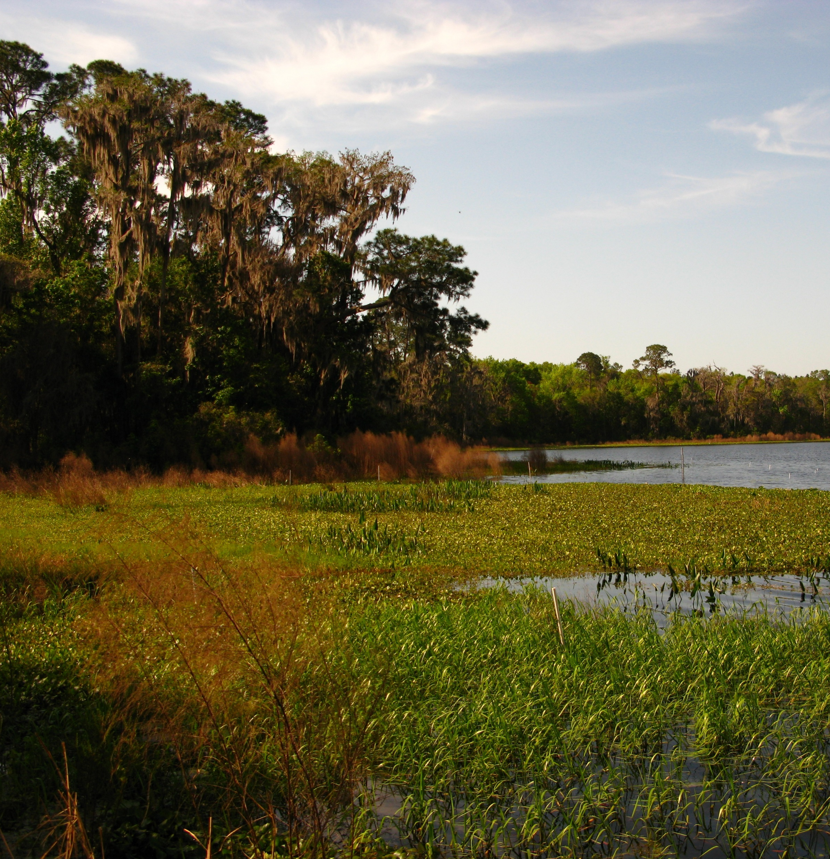
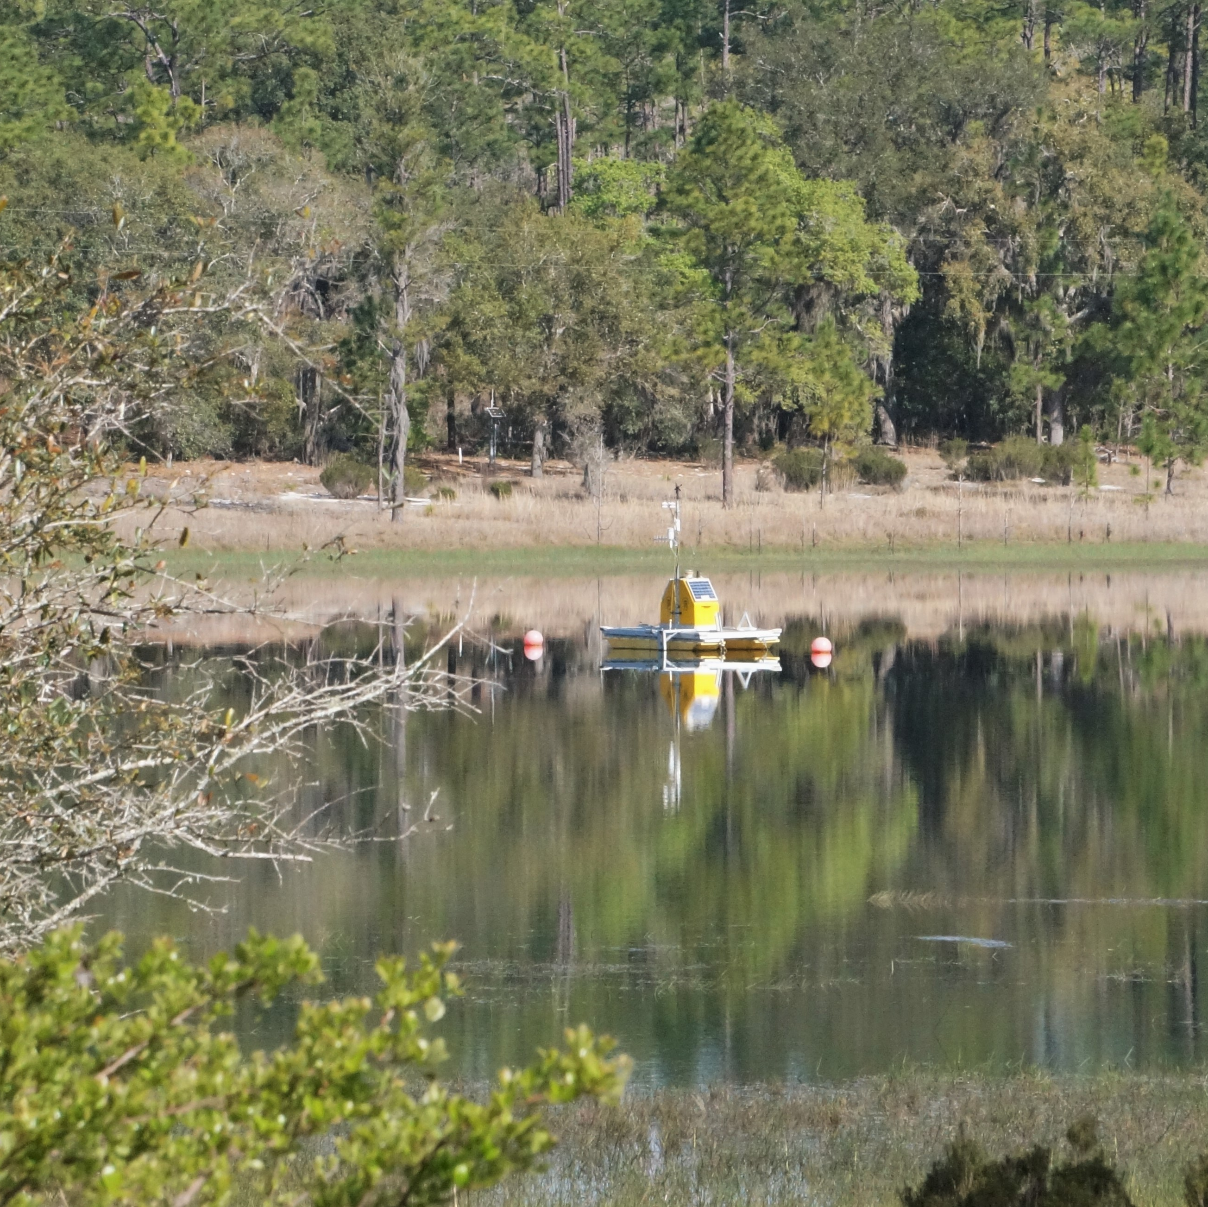
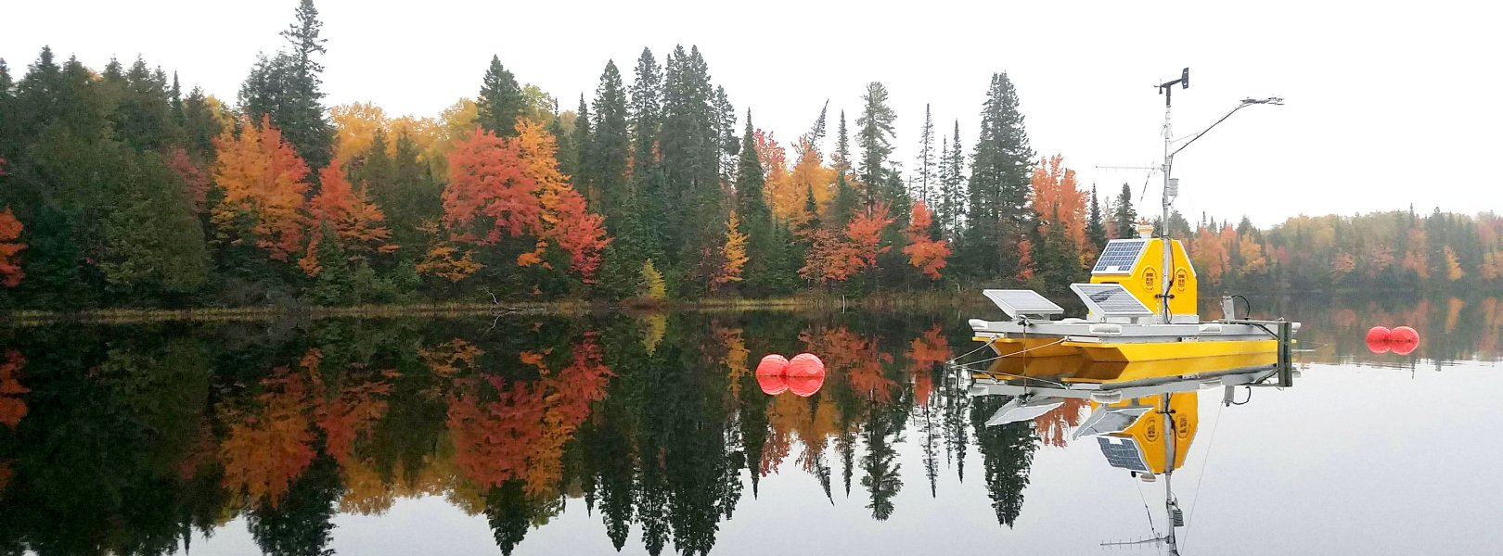
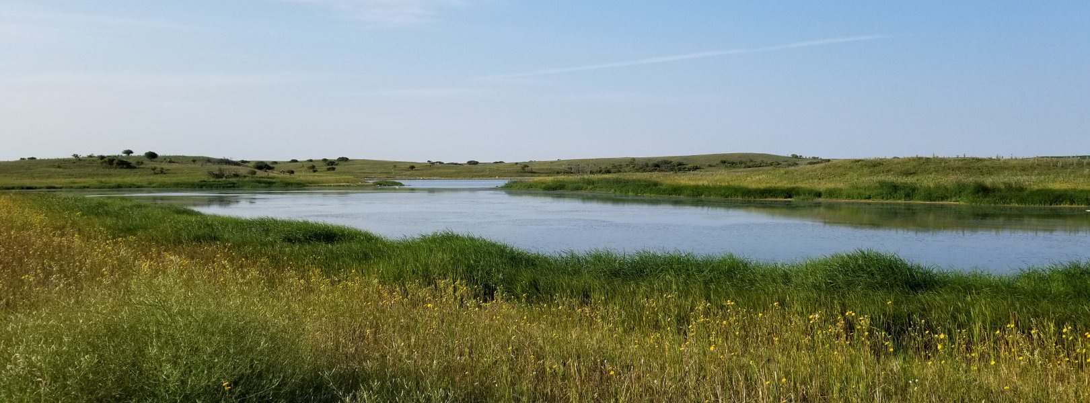
Diversity of NEON aquatic sites
Notes:
Data that we will be using is collected by automated sensors at the sites (NEON Aquatic Instrument System (AIS), see https://www.neonscience.org/field-sites/about-field-sites).
Data collected and quality checked by NEON are further processed to the targets format which is distributed to teams

Slide 19
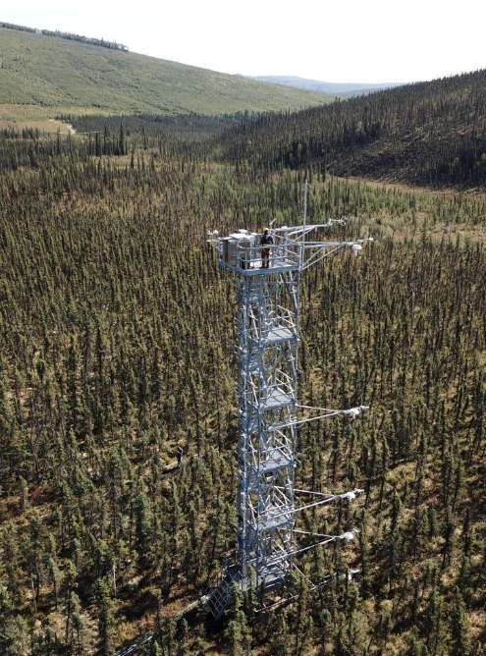
Hands-on workshop:
NEE = the net carbon balance of the ecosystem, a measurement of carbon storage rate.
Terrestrial daily theme – Can be predict how much C is going to be absorbed by ecosystems?
net ecosystem exchange (NEE)
NEONs eddy covariance data product (DP4.00200.001)
30 day forecast horizon
Data latency of 5 days
Simple baseline model to build on
NEON Eddy covariance tower at BONA (Fairbanks, AK)
Notes:
IF you are focusing on terrestrial Data collected across all 47 terrestrial
Why do we care about terrestrial theme? Carbon fluxes important – natural climate solutions
How much C is being absorbed by ecosystems?
We are using a simple model (not necessarily a good forecast) to demonstrate a full workflow (from data to models, uncertainty, and submission)

Slide 20
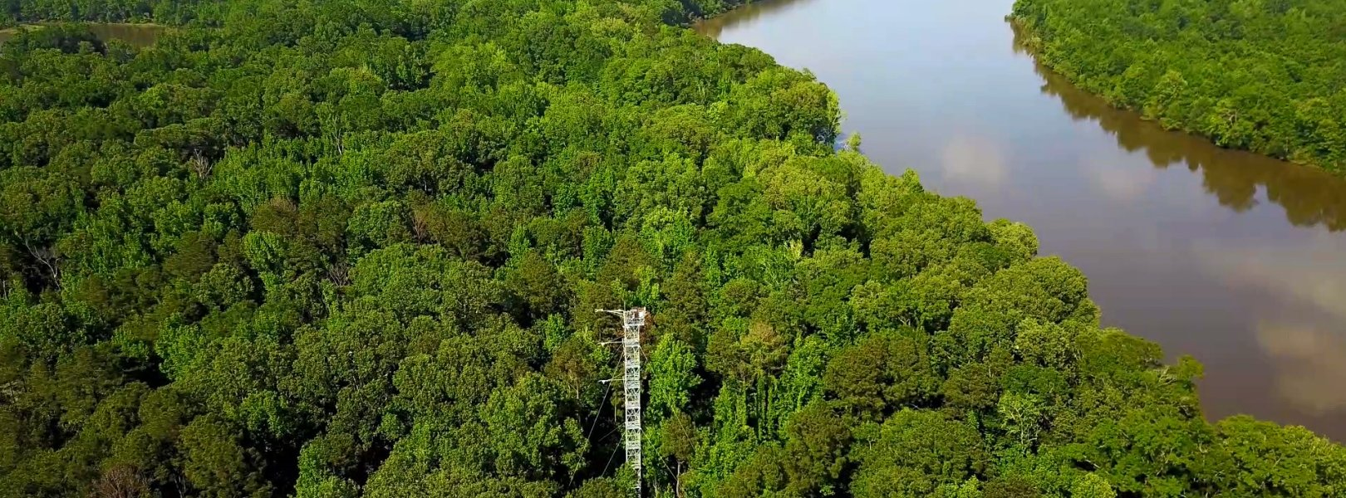
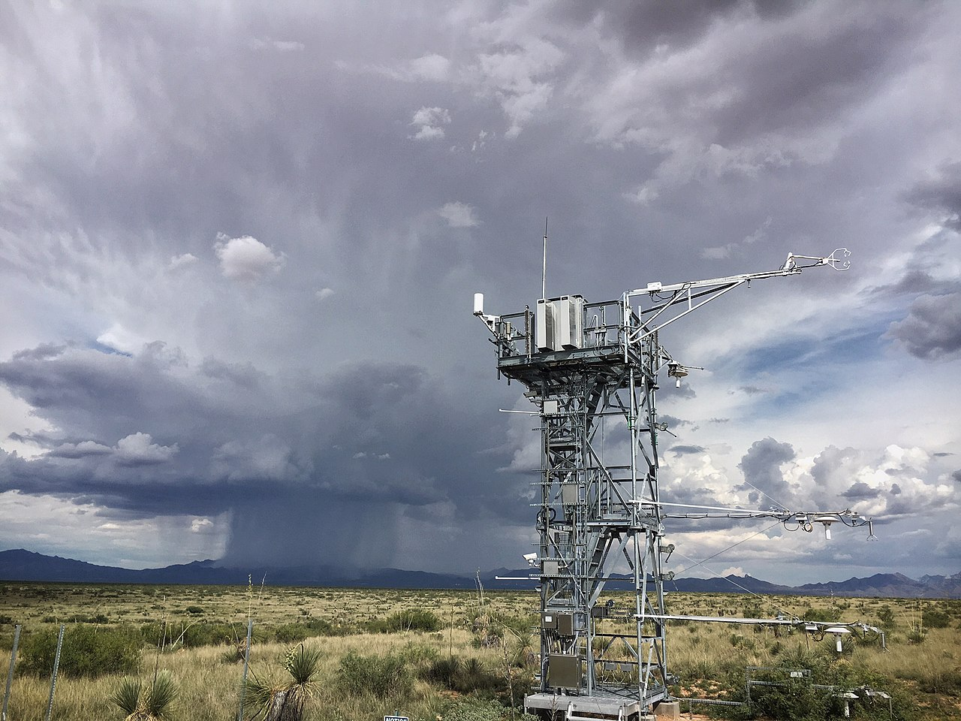
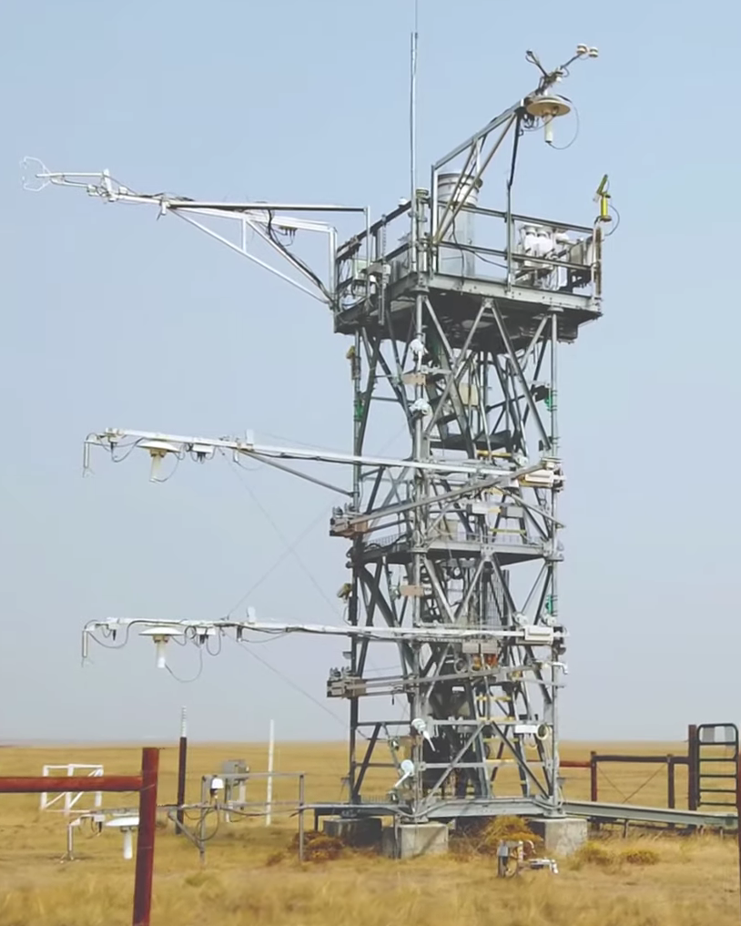
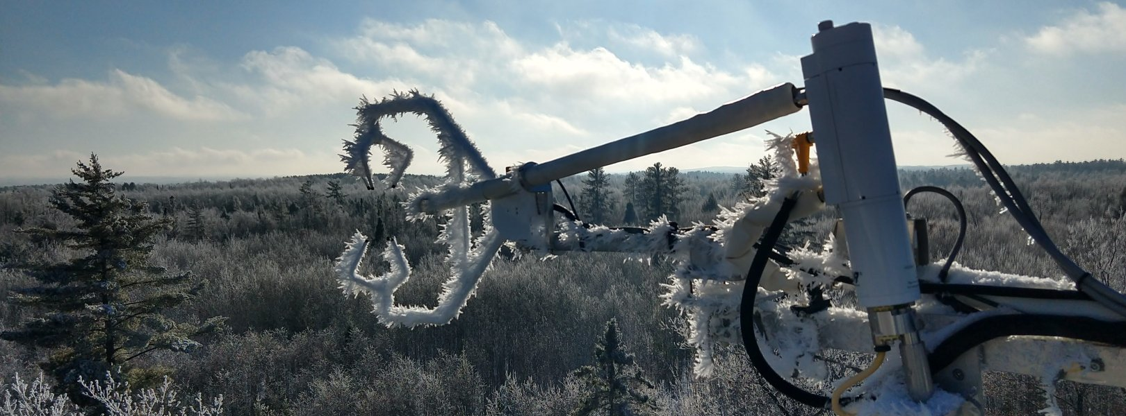
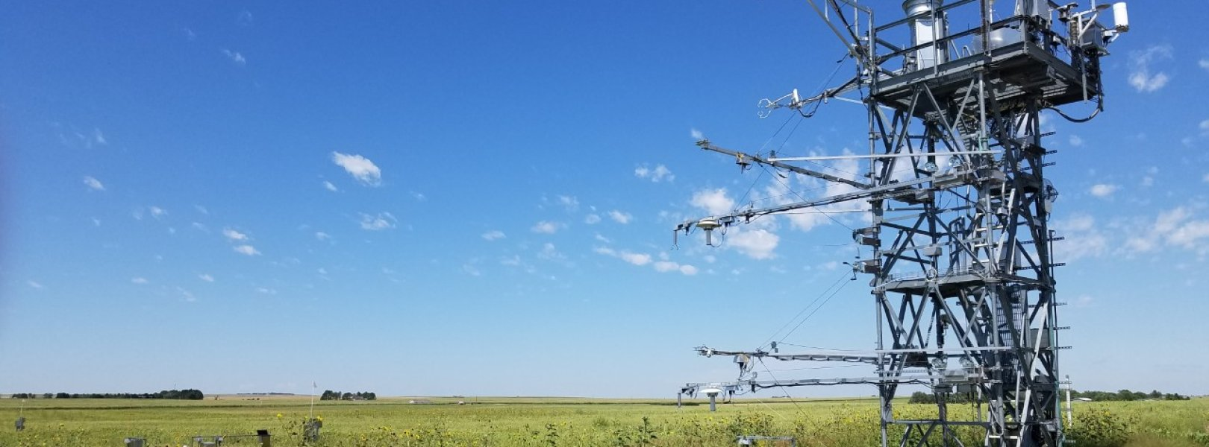
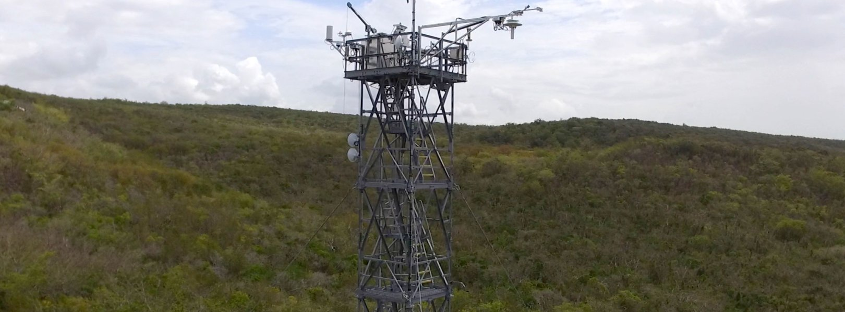
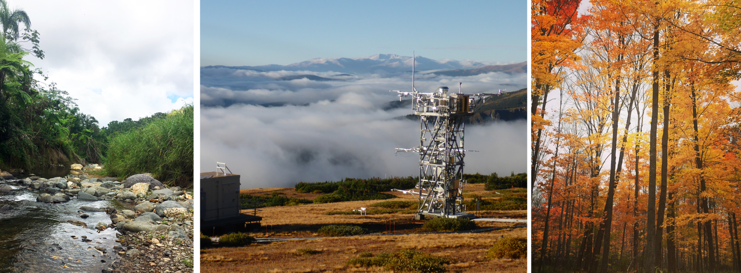
Diversity of NEON sites
Learn more: https://www.youtube.com/watch?v=CR4Anc8Mkas

Slide 21
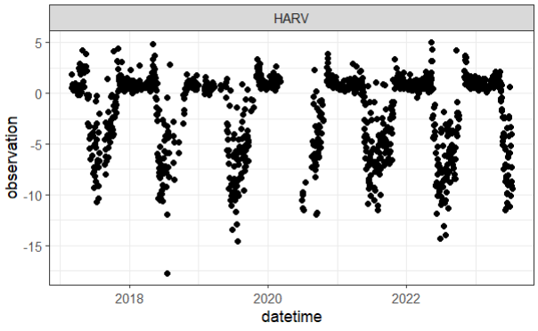
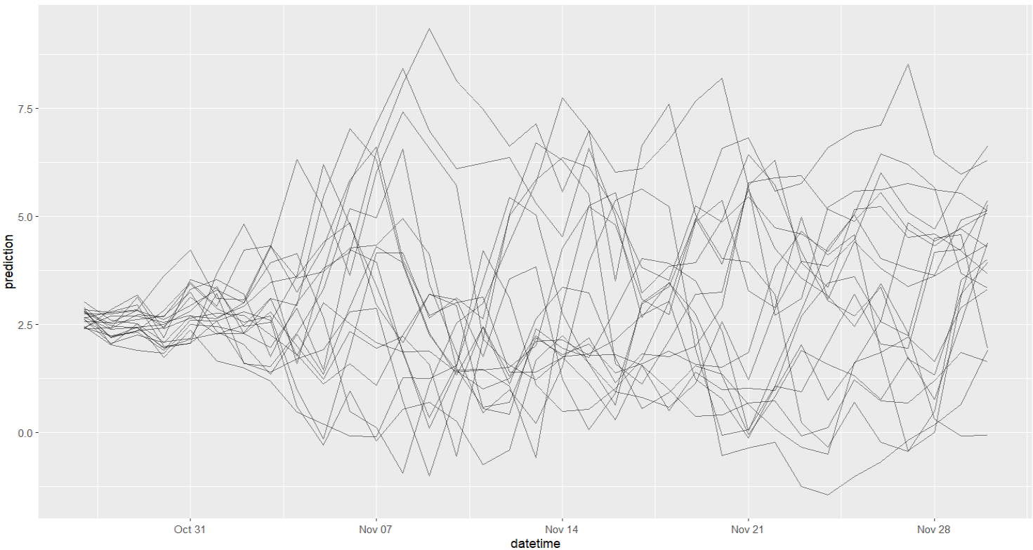
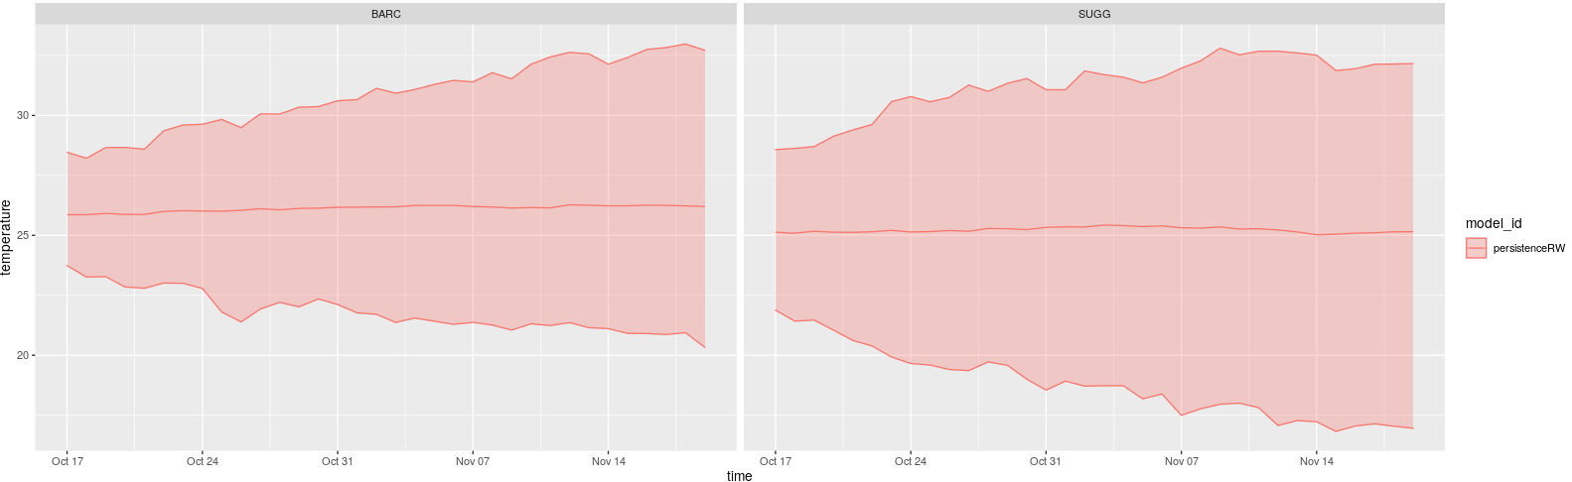
Some forecast terminology:
Targets – water temperature
Uncertainty – forecasts must include an estimate of uncertainty. The uncertainty can be represented using different model runs (ensemble members) or the statistics of the forecast (mean and standard deviation).
Notes:
Some terminology that will come up in the workshop. Figure shows targets or observations (top). Not always raw data. Sometimes targets are derived from observations (subset, averaging etc.) But this is what we are trying to forecast and what will be used in evaluation.
Forecasts are inherently uncertain and there needs to be some estimate of what this is. This can be presented in one of two ways – an ensemble forecast (middle) that has multiple simulations of the future or by reporting the mean and standard deviation (bottom)

Slide 22
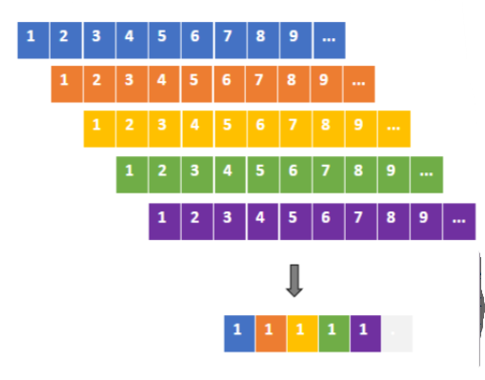
Some more forecast terminology:
NOAA data – National Oceanic and Atmospheric Administration weather forecasts
3 NOAA forecast data products available in neon4cast:
Stage_1: raw forecasts from NOAA. 30 member ensemble forecast
Stage_2: processed from stage_1 Recommended for future forecasts. Hourly inputs
Stage_3: the historic data product. A 'stacked' data set taking every 1 day ahead forecast. Useful for model training/calibration.
Notes:
We will be using NOAA weather forecast products in our predictions. These forecasts have multiple simulations so teams can include this as a source of uncertainty in their ecological forecasts. Challenge organisers have compiled 3 data products that all teams can use to drive models and ensure consistency between ecological forecasts. These are the stage 1 and 2 data – the raw and processes ensemble weather forecasts. They have also developed an estimate of historical conditions called a stacked data product which can be used to train models. Takes all the 1 day ahead forecasts as a good estimate of observed conditions.
This gives a consistent data product that can be used for training and then forecasting (not switching between observations and models which could be biased, ensures consistent bias between training and forecasting).

Slide 23
A little more forecast terminology:
Scores – a means to assess forecast skill. The Challenge uses the Continuous Rank Probability Score (crps). Uses both the accuracy (mean) and the precision (sd) of the forecast.
Scores → Dashboard → Users!
Read more: https://projects.ecoforecast.org/neon4cast-docs/Evaluation.html
Notes:
Some other terms that I might use but you don’t need to worry too much about are the scores – this is how the submitted forecasts are evaluated, how well did we do at forecasting the future. The method used by the Challenge incorporates the accuracy and the precision of the forecast – so how close where the predictions to the observation and how certain were we about that.
Scores are automatically generated and pushed to the dashboard for teams to see.
Read more about scores here https://projects.ecoforecast.org/neon4cast-docs/Evaluation.html

Slide 24
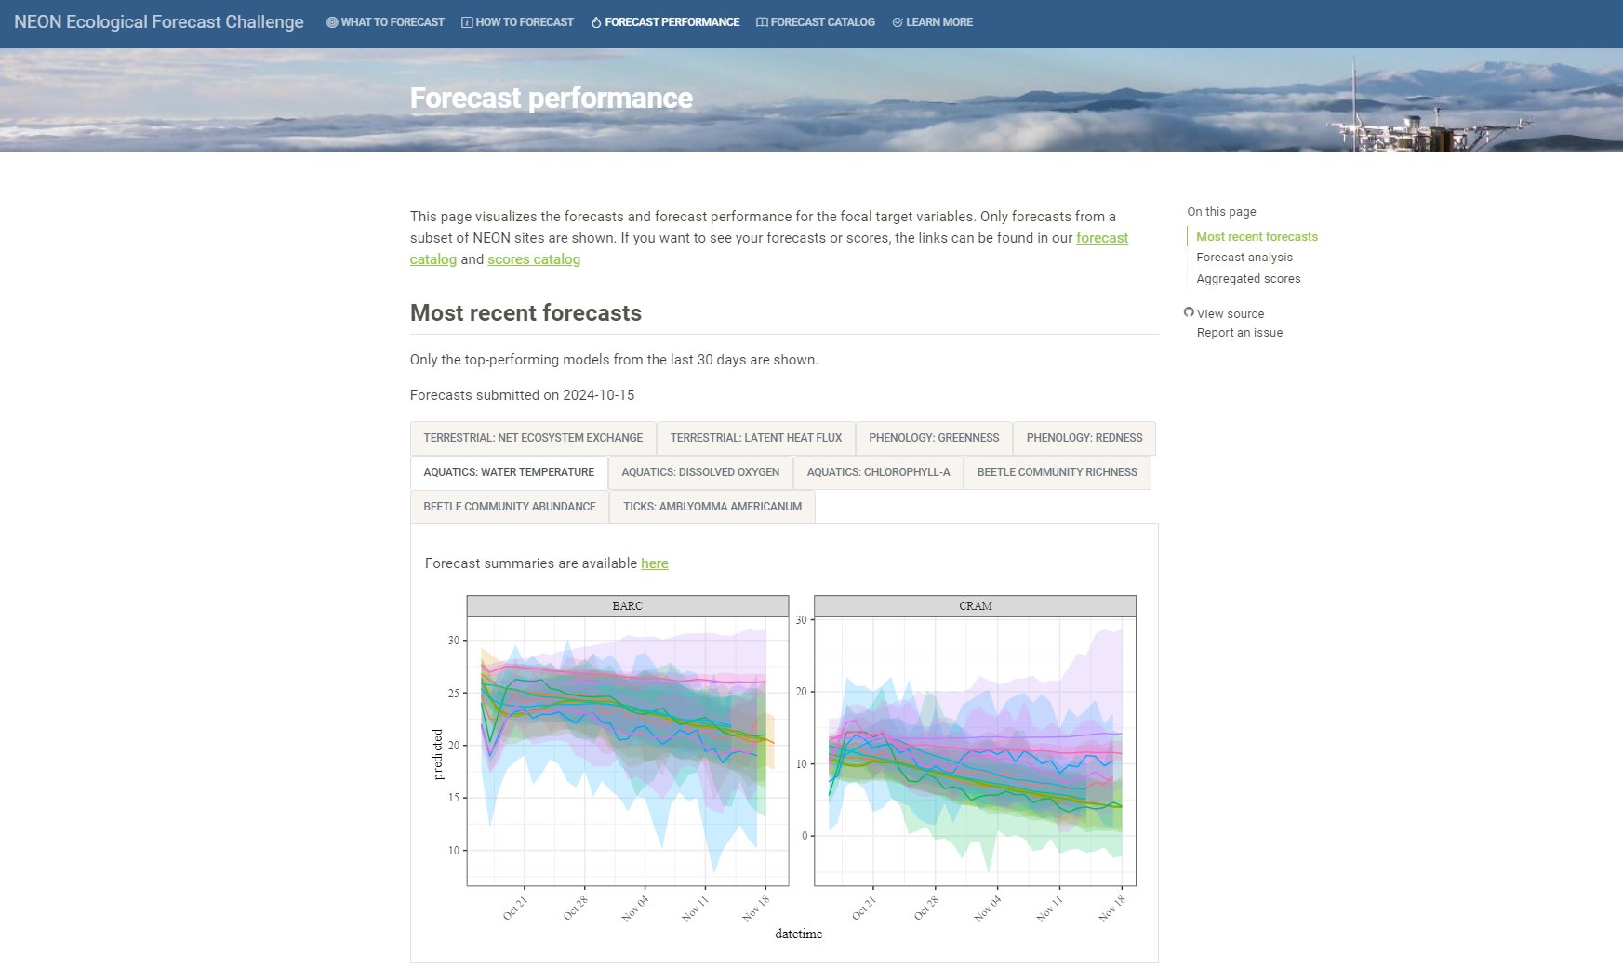
https://projects.ecoforecast.org/neon4cast-ci/
Notes:
The Challenge includes a dashboard where all submitted forecasts are visualized. Once you have made a submission you can go and see how it performs relative to other submissions and baseline models.

Slide 25

A little more forecast terminology:
Standards - Help maintain consistency in forecast generation, submissions and scoring
Need to submit a forecast in a standardized format
file format (csv or NetCDF)
file name format ([theme]-[reference_datetime]-[team_name].csv)
specific column names
column format (datetime/character/integer/etc.)
Notes:
The standards are a set of requirements for formats etc. that help consistency and the automate methods – things need to have particular names and formats.
See here https://projects.ecoforecast.org/neon4cast-docs/Submission-Instructions.html

Slide 26










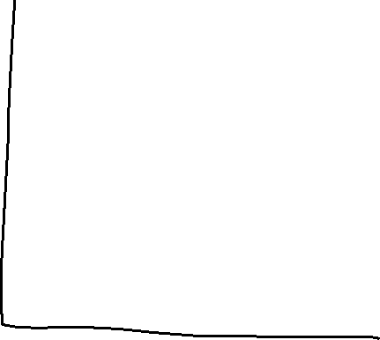
Notes:
Before starting on the hands-on portion of the tutorial it’s a good idea to visualize what a forecast that we generate could look like based on the Challenge’s required standards.
This drawing shows the targets are observations (blue points) of our chosen variable (water temperature, green). The forecast is for a particular NEON location (4-character NEON code, orange). The date that the forecast is generated is the vertical blue line, between past and future and is termed the reference datetime. If a forecast was generated today, then the reference datetime would be today’s date and each of the associated predictions would be for a particular date (red). To represent uncertainty this forecast uses multiple predictions or ensemble members. The identify of the ensemble member is given by the parameter number – in this case 1 to 4.

Slide 27
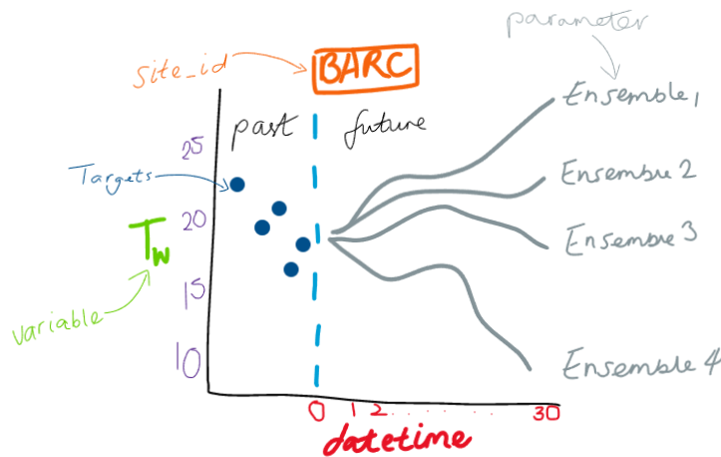
datetime | reference_datetime | site_id | family | parameter | variable | prediction | model_id
2023-01-12 | 2023-01-11 | BARC | ensemble | 1 | temperature | 22.63563 | test_mod
2023-01-12 | 2023-01-11 | BARC | ensemble | 2 | temperature | 26.75148 | test_mod
2023-01-12 | 2023-01-11 | BARC | ensemble | 3 | temperature | 24.65157 | test_mod
2023-01-12 | 2023-01-11 | BARC | ensemble | 4 | temperature | 25.1389 | test_mod
… | … | … | … | … | … | … | test_mod
2023-02-10 | 2023-01-11 | BARC | ensemble | 1 | temperature | 19.40379 | test_mod
2023-02-10 | 2023-01-11 | BARC | ensemble | 2 | temperature | 24.89667 | test_mod
2023-02-10 | 2023-01-11 | BARC | ensemble | 3 | temperature | 25.98961 | test_mod
2023-02-10 | 2023-01-11 | BARC | ensemble | 4 | temperature | 26.40593 | test_mod
https://projects.ecoforecast.org/neon4cast-ci/instructions.html
Notes:
This drawing would be represented in a data frame that looks like this. This includes the require columns names and formats. The family and parameter columns are crucial for describing the uncertainty representation in the forecast. The family describes how the uncertainty is represented in this case an ensemble but if the uncertainty is drawn from a distribution (e.g. normal, binomial etc.) that distribution would be listed in the family. For an ensemble forecast parameter is the ensemble number, but for a distributional forecast these would be the parameters of that distribution (e.g. for a normal distribution it would be mu (mean) and sigma (sd)). A full description of the required columns and possible families can be found https://projects.ecoforecast.org/neon4cast-ci/instructions.html
Update the dates to more recent to reflect what participants might see.

Slide 28
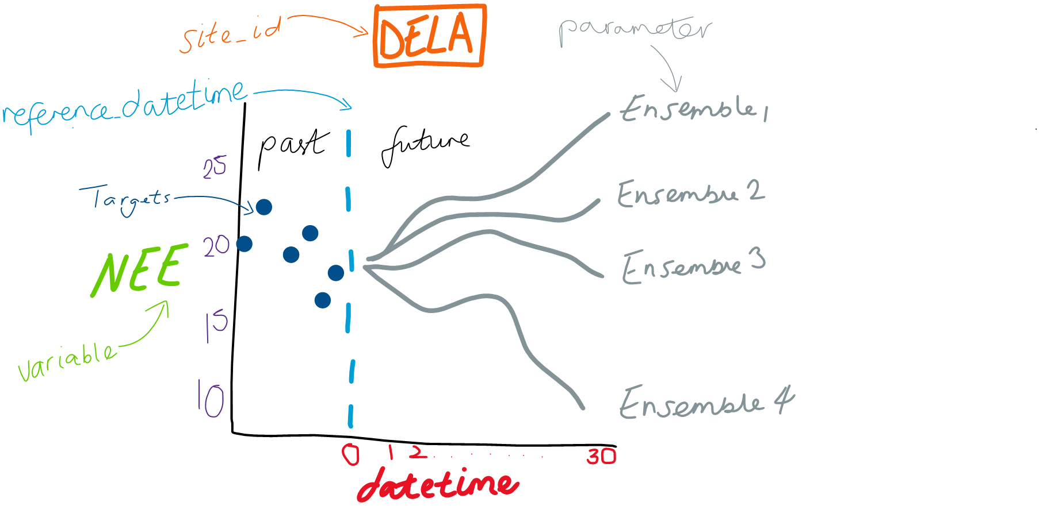
Notes:
Before starting on the hands-on portion of the tutorial it’s a good idea to visualize what a forecast that we generate could look like based on the Challenge’s required standards.
This drawing shows the targets are observations (blue points) of our chosen variable (NEE, green). The forecast is for a particular NEON location (4-character NEON code, orange). The date that the forecast is generated is the vertical blue line, between past and future and is termed the reference datetime. If a forecast was generated today, then the reference datetime would be today’s date and each of the associated predictions would be for a particular date (red). To represent uncertainty this forecast uses multiple predictions or ensemble members. The identify of the ensemble member is given by the parameter number – in this case 1 to 4.

Slide 29
datetime | reference_datetime | site_id | family | parameter | variable | prediction | model_id
2023-08-02 | 2023-08-01 | DELA | ensemble | 1 | nee | 5.551 | test_mod
2023-08-02 | 2023-08-01 | DELA | ensemble | 2 | nee | 4.547 | test_mod
2023-08-02 | 2023-08-01 | DELA | ensemble | 3 | nee | 2.227 | test_mod
2023-08-02 | 2023-08-01 | DELA | ensemble | 4 | nee | 3.214 | test_mod
… | … | … | … | … | … | … | test_mod
2023-09-02 | 2023-08-01 | DELA | ensemble | 1 | nee | 6.852 | test_mod
2023-09-02 | 2023-08-01 | DELA | ensemble | 2 | nee | 2.247 | test_mod
2023-09-02 | 2023-08-01 | DELA | ensemble | 3 | nee | 5.961 | test_mod
2023-09-02 | 2023-08-01 | DELA | ensemble | 4 | nee | 4.593 | test_mod
https://projects.ecoforecast.org/neon4cast-ci/instructions.html
Notes:
In a csv format that meets standards it might look like this. One important thing to understand is the idea of a reference_Datetime or the date when the forecast was generated. Here you can see the forecast was generated on 1st August and goes out 30 days into the future. Family and parameter describe the type of forecast it is – family is ensemble and the parameter is the ID of each ensemble member
This drawing would be represented in a data frame that looks like this. This includes the require columns names and formats. The family and parameter columns are crucial for describing the uncertainty representation in the forecast. The family describes how the uncertainty is represented in this case an ensemble but if the uncertainty is drawn from a distribution (e.g. normal, binomial etc.) that distribution would be listed in the family. For an ensemble forecast parameter is the ensemble number, but for a distributional forecast these would be the parameters of that distribution (e.g. for a normal distribution it would be mu (mean) and sigma (sd)). A full description of the required columns and possible families can be found https://projects.ecoforecast.org/neon4cast-ci/instructions.html

Slide 30
Basic workflow to submit a forecast
Read EFI-NEON Challenge documentation (neon4cast.org)
Investigate the forecast target variables
Build/apply your model!
Produce forecast of future conditions – SUBMIT TO THE CHALLENGE!
Register, complete model description, and submit your forecasts
Wait for the scores to come in and revel in the glory of predicting the future (~5-day before first evaluation)
Use new data to update the model
Submit another forecast! And another…!
Workflow automation
See detailed instructions here https://projects.ecoforecast.org/neon4cast-ci/instructions.html
Notes:
To put this together this is what a simple forecasting workflow might look like to submit to the NEON Challenge. Lots of great documentation and templates and tools to help you get started
Get involved in the iterative nature of forecasting, submit/improve your forecast every day. Use data assimilation techniques to modify starting conditions
https://projects.ecoforecast.org/neon4cast-ci/instructions.html

Slide 31
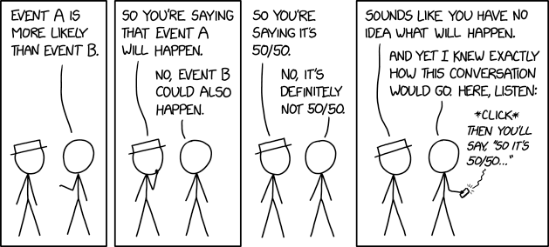
Questions?
https://xkcd.com/2370

Slide 32
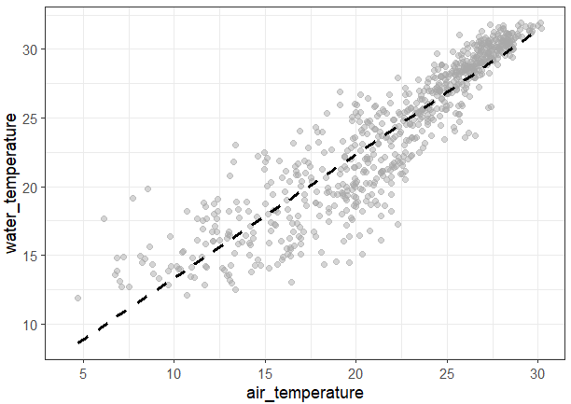
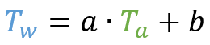
Let’s forecast!
Follow-along R markdown
Forecasting water temperature using a Linear model with air temperature
Modify the model and submit your forecast!
More/other covariates
Different model structures
Other variables
Notes:
A preview of the forecasting model to be used – forecasting water temperature as a function of air temperature using weather forecasts

Slide 33
Let’s forecast!
Follow-along R markdown
Forecasting Net Ecosystem Exchange using a Linear model with air temperature and short-wave radiation
Or just watch along!
Modify the model and submit your forecast!
More/other covariates
Different model structures
Other variables
$$NEE=c+b∙AT+a∙SWR$$
Notes:
A preview of the forecasting model to be used – forecasting NEE as a function of air temperature and short wave radition using weather forecasts

Slide 34
Thank you for attending!
Big thanks to the EFI-NEON team - especially Quinn Thomas (Virginia Tech) and Carl Boettiger (UC-Berkley) developers of the cyberinfrastructure underpinning the Challenge.
For questions contact eco4cast.initiative@gmail.com
Visit ecoforecast.org & neon4cast.org

